Slide 1
ES 创建索引源码走读
马可阳

Slide 2
相关数据结构-1
clusterState
version
stateUUID
RoutingTable
DiscoveryNodes
MetaData
blocks
customs
clusterName
routingNodes // built on demand
settingsFilter
ClusterStateStatus
UNKNOWN
RECEIVED
BEING_APPLIED
APPLIED

Slide 3
相关数据结构-2
MetaData
clusterUUID
version
Settings transientSettings
Settings persistentSettings
Settings settings
indices（name-->IndexMetaData）
templates(name-->IndexTemplateMetaData)

Slide 4
相关数据结构-3
indexMatadata
index
version
state
OPEN
CLOSE
aliases
settings
mappings
customs
totalNumOfShards
requireFilters
includeFilters
excludeFilters
Version indexCreatedVersion
Version indexUpgradedVersion

Slide 5
IndexTemplateMetaData
name
order
template
settings
mappings
aliases

Slide 6
相关数据结构-4
AliasMetaData
alias
filter
indexRouting
searchRouting
searchRoutingValues

Slide 7
相关数据结构-5
MappingMetaData
type
source
id
routing
timestamp
hasParentField

Slide 8
相关数据结构-6
DiscoveryNodes
<String, DiscoveryNode> nodes
<String, DiscoveryNode> dataNodes
<String, DiscoveryNode> masterNodes
DiscoveryNode
nodeName
nodeId
hostName
hostAddress
address
<String, String> attributes
version

Slide 9
相关数据结构-7
RoutingTable
<indexname ---> IndexRoutingTable>
IndexRoutingTable
shardid ----> IndexShardRoutingTable
IndexShardRoutingTable
shardid ---> shardRouting
shardRouting
index
shardId
currentNodeId
relocatingNodeId
primary
state(UNASSIGNED((byte) 1),INITIALIZING((byte) 2),STARTED((byte) 3),RELOCATING((byte) 4);)
version

Slide 10
相关数据结构-8
RoutingNodes
<String, RoutingNode> nodesToShards
RoutingNode
nodeId
DiscoveryNode
List<ShardRouting> shards

Slide 11
RestCreateIndexAction.handleRequest
Client的类型：
BaseRestHandler. HeadersAndContextCopyClient
Client.admin()的类型：
AbstractClient.ClusterAdmin
client.admin().indices()的类型：
AbstractClient. IndicesAdmin

Slide 12
NodeClient. doExecute()
TransportAction.execute()
TransportMasterNodeAction.doExecute()
TransportMasterNodeAction.innerExecute
TransportCreateIndexAction.masterOperation
final String indexName = indexNameExpressionResolver.resolveDateMathExpression(request.index());
https://www.elastic.co/guide/en/elasticsearch/reference/2.1/date-math-index-names.html#date-math-index-names

Slide 13
MetaDataCreateIndexService. createIndex
clusterService.submitStateUpdateTask
UpdateTask.run

Slide 14
curl -XPOST aliases -d '{
"actions" : [
{
"add" : {
"index" : "test1",
"alias" : "alias2",
"filter" : { "term" : { "user" : "kimchy" } }
}
}
]
}'
curl -XPOST 'http://localhost:9200/_aliases' -d '
{
"actions" : [
{
"add" : {
"index" : "test",
"alias" : "alias1",
"routing" : "1“,
"search_routing" : "1,2",
"index_routing" : "2"
}
}
]
}'

Slide 15
MetaDataCreateIndexService.createIndex. AckedClusterStateUpdateTask.execute
alias处理
mapping的处理
setting的处理
AUTO_EXPAND_REPLICAS
The only documented values are "false" or "0- all

Slide 16
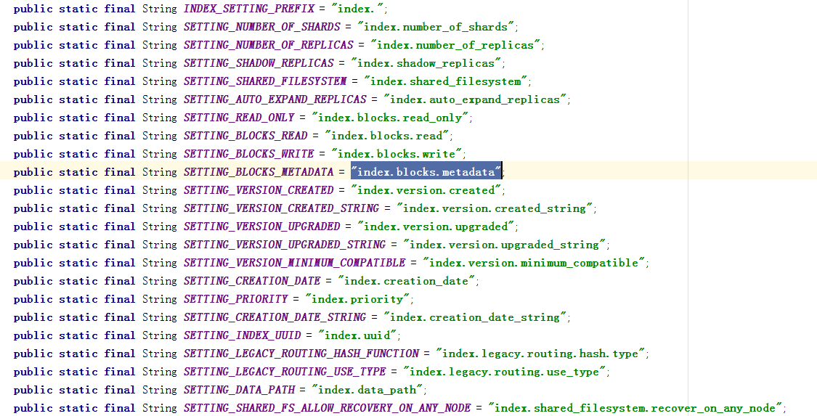

Slide 17
// create the index here (on the master) to validate it can be created, as well as adding the mapping
indicesService.createIndex(request.index(), actualIndexSettings, clusterService.localNode().id());

Slide 18
indexService.indicesLifecycle().beforeIndexAddedToCluster(new Index(request.index()), indexMetaData.getSettings());
----没有动作

Slide 19
RoutingTable.Builder routingTableBuilder = RoutingTable.builder(updatedState.routingTable()) .addAsNew(updatedState.metaData().index(request.index()))
创建shardRouting, 状态为unassigned, 未分配node

Slide 20
RoutingAllocation.Result routingResult = allocationService.reroute(ClusterState.builder(updatedState).routingTable(routingTableBuilder).build());
--目前为止ES中最复杂的代码逻辑
shardsAllocators.allocateUnassigned(allocation)
BalancedShardsAllocator.allocateUnassigned

Slide 21
routingNodes.initialize(shard, routingNodes.node(minNode.getNodeId()).nodeId(), allocation.clusterInfo().getShardSize(shard, ShardRouting.UNAVAILABLE_EXPECTED_SHARD_SIZE));
将shardRouting的状态由UNASSIGNED变为INITIALIZING，将shard分配到node

Slide 22
indicesService.removeIndex
indicesLifecycle.beforeIndexClosed(indexService)
没有动作
Closing XXX

Slide 23
回到InternalClusterService.UpdateTask.run
discoveryService.publish(clusterChangedEvent, ackListener)
ZenDiscovery.publish
更新FD
publishClusterState.publish(clusterChangedEvent, ackListener)

Slide 24
listener.clusterChanged(clusterChangedEvent)
preAppliedListeners
RoutingService
IndicesClusterStateService
NodeSettingsService
InternalClusterInfoService
RepositoriesService
MetaDataUpdateSettingsService
RestoreService
InternalClusterService$LocalNodeMasterListeners
GatewayAllocator$1
SnapshotsService
SnapshotShardsService
IndicesStore
Gateway
GatewayService

Slide 25
IndicesClusterStateService.clusterChanged
applyNewIndices(event)
applyNewOrUpdatedShards(event)
applyInitializingShard
IndexShard indexShard = indexService.createShard(shardId, shardRouting)
------ state = IndexShardState.CREATED
indexShard.updateRoutingEntry
indicesLifecycle.shardRoutingChanged—没有动作
赋值shardRouting
持久化shardMetadata
indexService.shard(shardId).recoverFromStore---加回调接口

Slide 26
IndexShard.recoverFromStore
shouldExist == false
storeRecoveryService.recover
indexShard.recovering---改变indexShard的状态，有created变为recovering
recoverFromStore

